Slide 1
MEDIA MENGAJAR
BRIGHT AN ENGLISH
FOR SMP/MTs GRADE VII

Slide 2
BAB 2
It’s Judy Spark!
Notes:
Jika terdapat gambar cantumkan sumber gambar dgn ukuran font 10pt

Slide 3
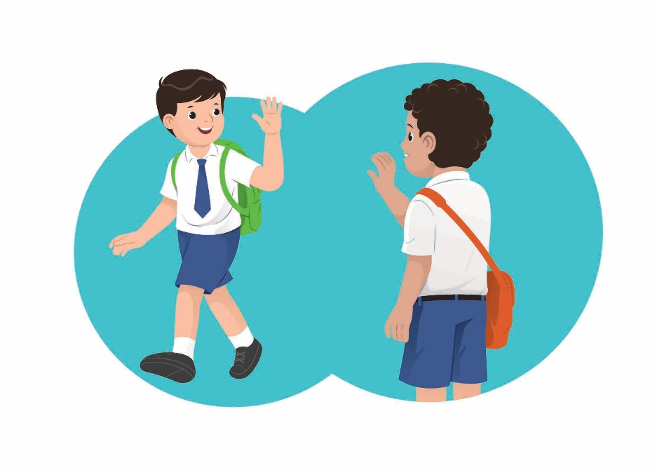
What do you do when you meet someone new?
We may want to know some information about them.
source: dokumen penerbit

Slide 4
A. Grammar Verb Be (To Be) Singular
Subject | To be | S + to be | Question | Answer
I | am (not) | I’m / I’m not | Am I? | Yes. I am. / No, I’m not.
You | are (not) | You’re / You’re not | Are you? | Yes, you are. /No, you aren’t.
He | is (not) | He’s / He’s not | Is he? | Yes, he is. / No, he isn’t.
She | is (not) | She’s / She’s not | Is she? | Yes, she is. / No, she isn’t.
It | is (not) | It’s / It’s not | Is it? | Yes, it is. / No, it isn’t.
They | are (not) | They’re / They’re not | Are they? | Yes, they are. / No, they aren’t.
We | are (not) | We’re / We’re not | Are we? | Yes, we are. / No, we aren’t.

Slide 5
Is it your book?
Yes, it is.
Thank you.
source: freepik.com/gpointstudio

Slide 6
Say them.
source: commons.wikimedia/Zscout370
source: commons.wikimedia/WikimediaCommons
source: commons.wikimedia/RiedleroD
Indonesia
Malaysia
United Kingdom
source: commons.wikimedia/Achim55
source: commons.wikimedia/WikimediaCommons
source: commons.wikimedia/WikimediaCommons
Brazil
America
Canada

Slide 7
B. Country and Nationality
Country | Nationality
Indonesia | Indonesian
Malaysia | Malaysian
Belgium | Belgian
Italy | Italian
Brazil | Brazilian
Turkey | Turkish
Spain | Spanish
Country | Nationality
Russia | Russian
China | Chinese
Japan | Japanese
Mexico | Mexican
Britain | British
America | American
England | English

Slide 8
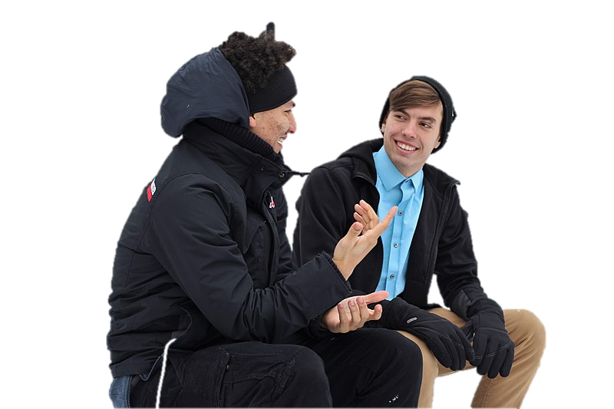
Practice the dialogue
Are you from China?
No, I’m not.
Where are you from?
I am from Brazil.
So, are you a Brazilian?
Yes, I am.
source: piqsels.com/Piqsels

Slide 9
C. Question Words
Who | Who is she?
 | Who are you?
What | What is your name?
 | What is your nationality?
Where | Where is your country?
 | Where are you from?
How old | How old are you?
 | How old is she?

Slide 10
Practice the dialogue
Alex : Hi, I’m Alex. I’m your new classmate.
What is your name?
Rania : Hello Alex, my name is Rania. Where are you from?
Alex : I’m from Texas.
Rania : Where is Texas? I don’t know.
Alex : It’s in America.
Rania : So, are you an American?
Alex : Yes, but my family is Mexican too. What do you love from
America?
Rania : I love the liberty statue, it’s so iconic and wonderful.

Slide 11
Summary
Questions used to ask about a person/people:
Who is he?
Who are you?
To know about a thing/things, we may ask, “What’s this?”
Questions to ask about a time:
When’s the carnival?
When’s your music lesson?

Slide 12
Ask, “Where’s Tokyo?” to know about a place.
To know about age, we ask, “How old are you?”
To get information about a number, we may ask, “How many trophies do you have?”

