Slide 1

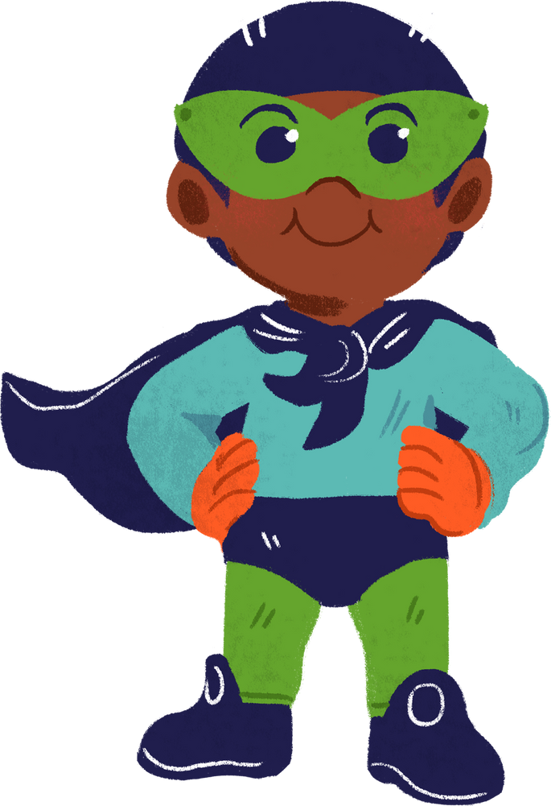

SIMPLE PAST TENSE QUIZ
FOR 9TH GRADE
Teacher:
Eka Syovi Arianti

Slide 2
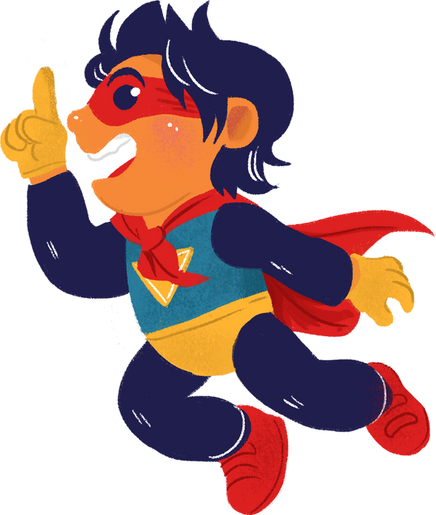

TO TAKE THE QUIZ:
Create a copy of the presentation.
Follow the activity instructions.
Share the presentation with your answers.

Slide 3



FIRST PHASE:
Classifying
Drag the verbs into the correct category.

Slide 4



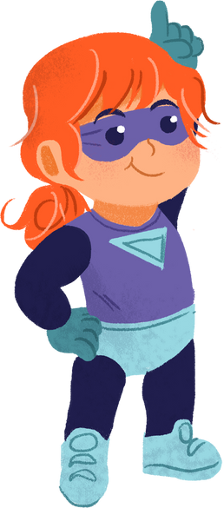
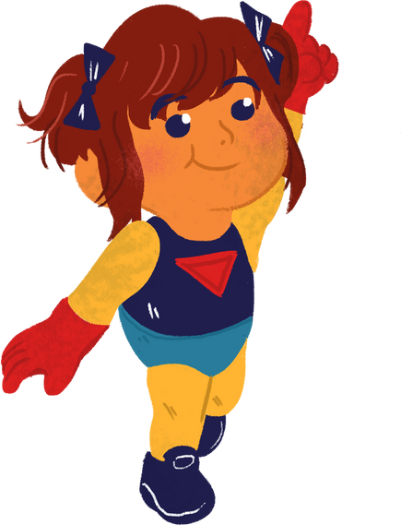
REGULAR
IRREGULAR
jump
fly
save
help
wear
stop
chase
think
catch
run
swim
rescue

Slide 5
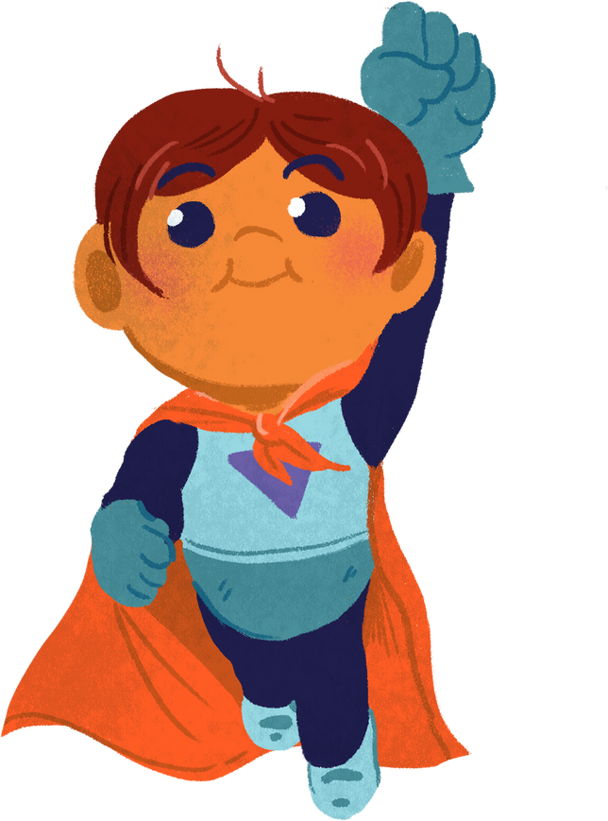

SECOND PHASE:
Mathcing
Match the verbs with their past forms.

Slide 6
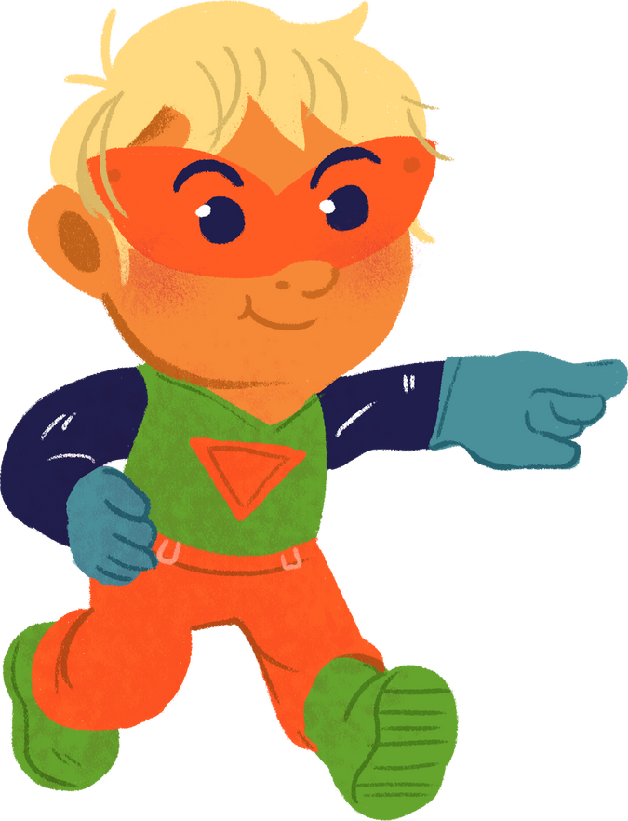




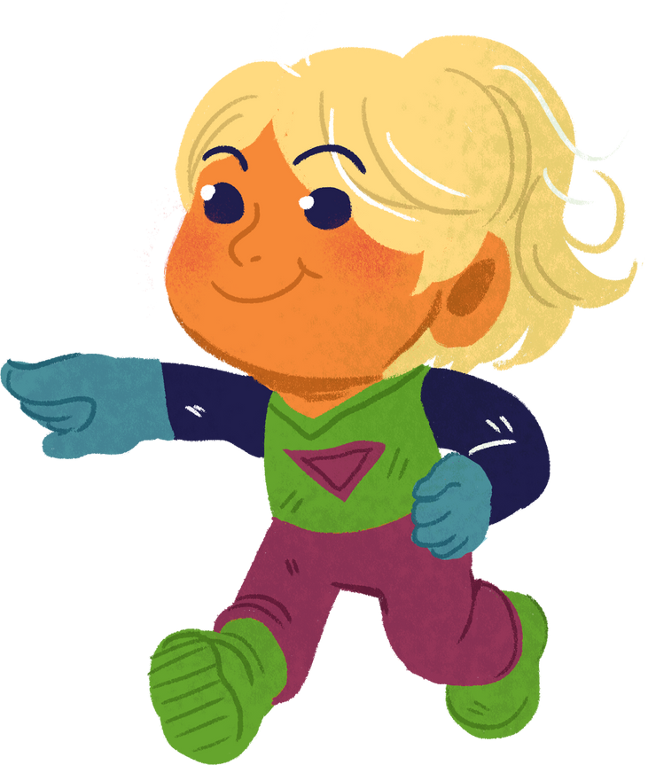
jump
jumped
save
ran
wear
wore
chase
chased
catch
caught
swim
swam
rescue
rescued
run
saved
think
thought
fly
flew

Slide 7
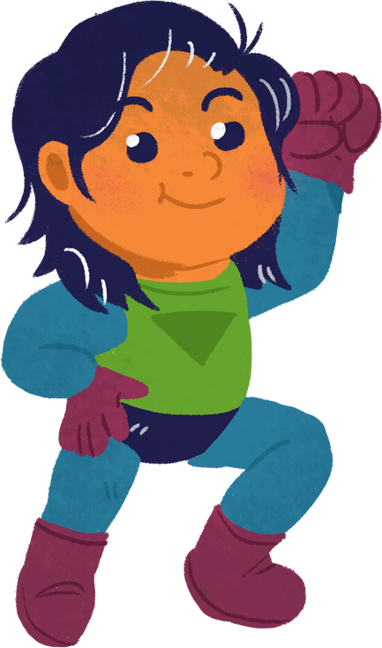

LAST PHASE:
Multiple Choice
Write the correct verb in its past form.

Slide 8
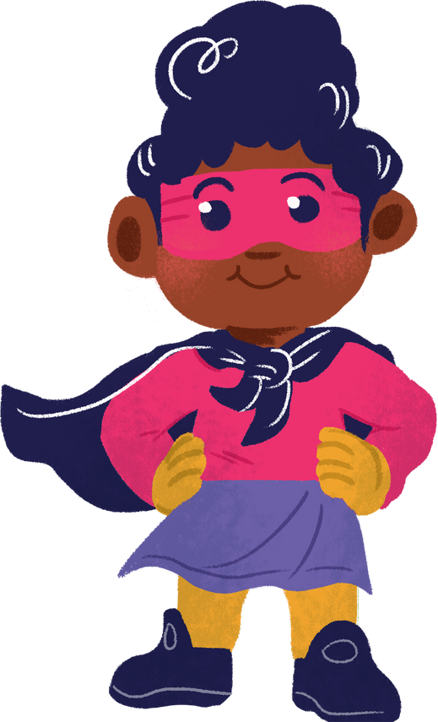
The superhero through the sky to rescue the civilians.
stop
fly
catch

Slide 9
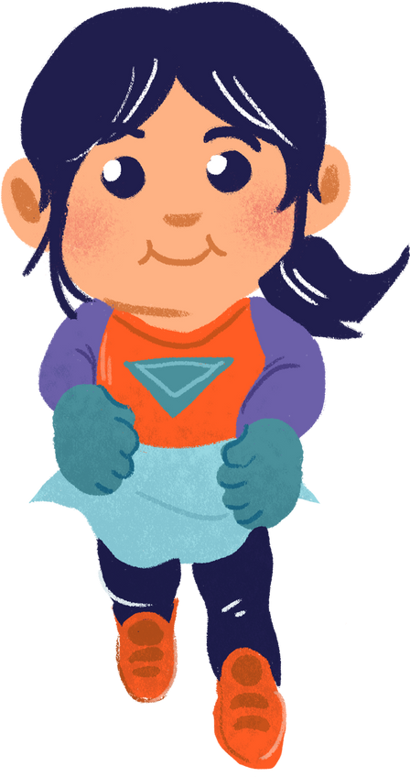

The superhero faster than a speeding bullet to save the day.
run
jump
rescue

Slide 10

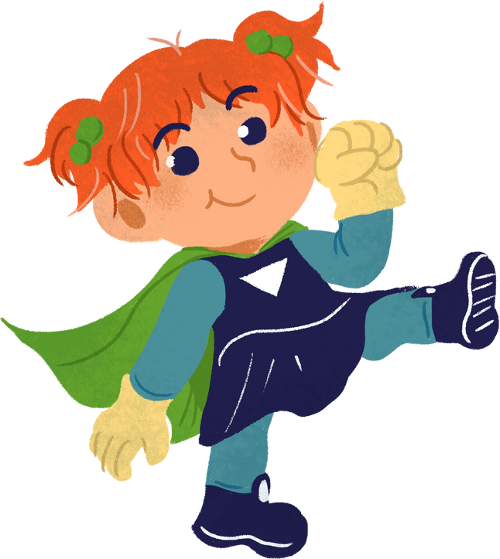
The superhero over the building to catch the villian.
swim
think
jump

Slide 11


The superhero the stranded hikers from the mountain top.
think
rescue
wear

Slide 12
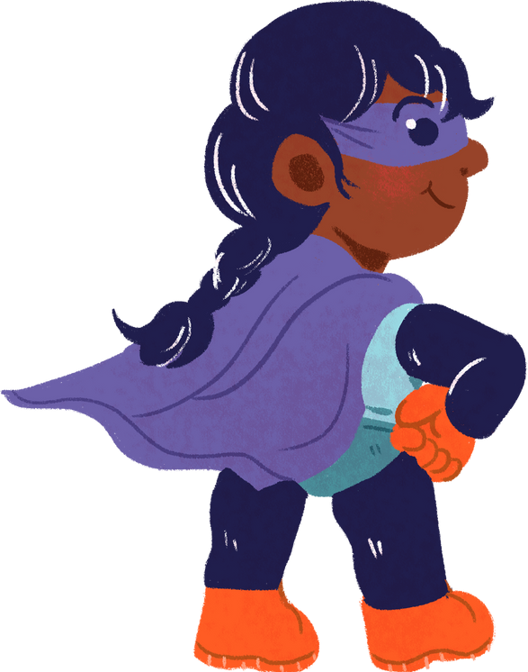
The superhero of a clever plan to stop the evil mastermind.
help
chase
think

Slide 13
The superhero a cape and mask to hide their true identity.
wear
help
fly

Slide 14

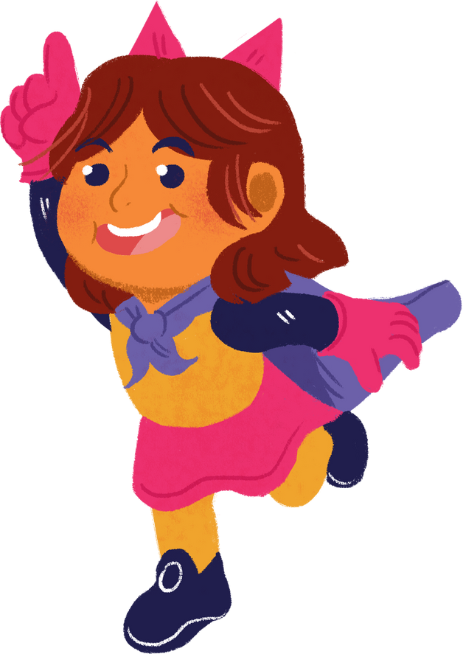
WELL DONE!
Now send the presentation with your answer to :
https://drive.google.com/drive/folders/1VtYkbDCIstbaVbnTtsi1Y0wwqdUvI5Aw?usp=sharing

